Slide 1
Customer Churn Analysis

Slide 2
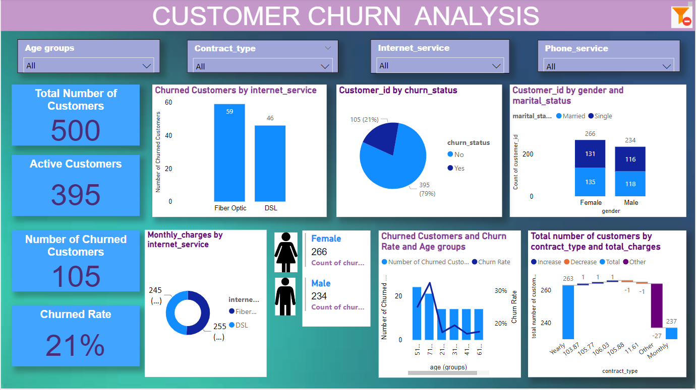

Slide 3


